Slide 1
Artificial Intelligence Lecture 9

Slide 2
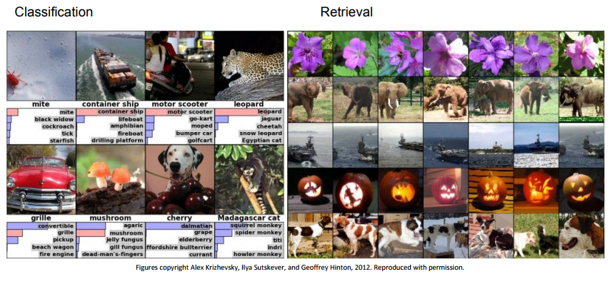
Convolutional Neural Networks

Slide 3
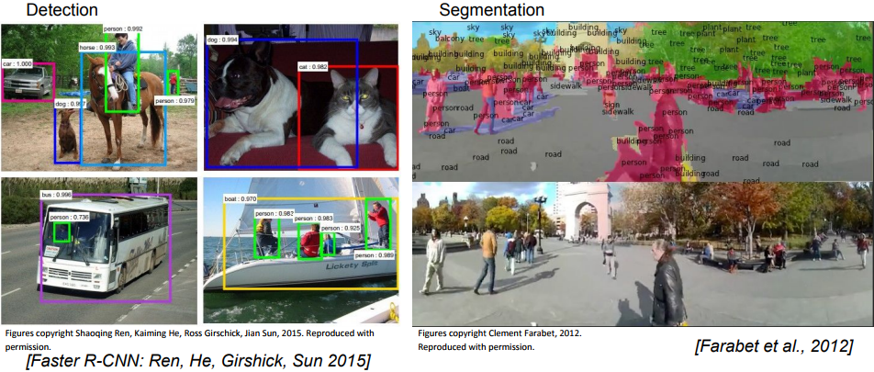
Convolutional Neural Networks

Slide 4
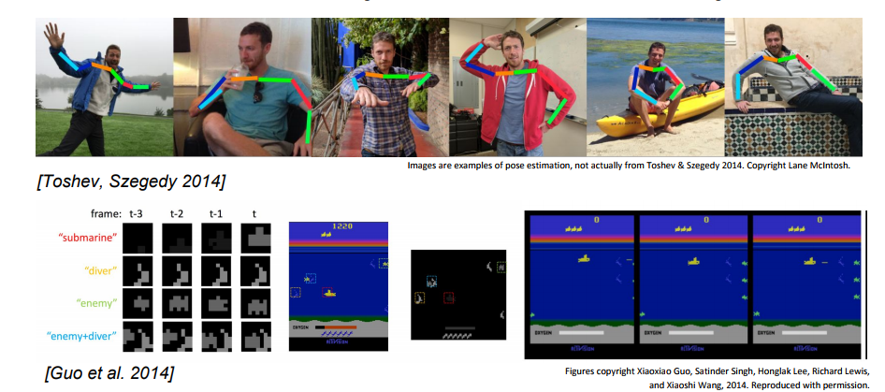
Convolutional Neural Networks

Slide 5
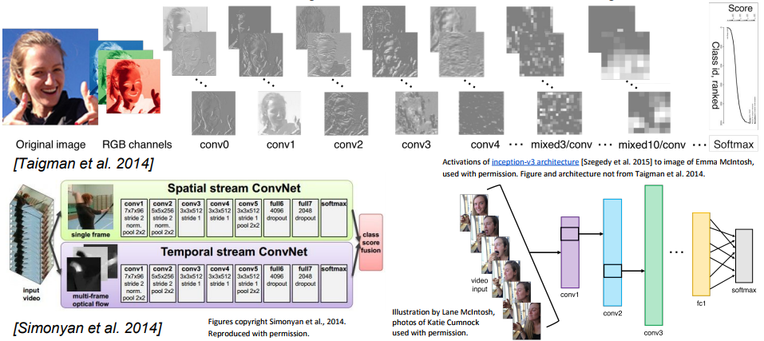
Convolutional Neural Networks

Slide 6
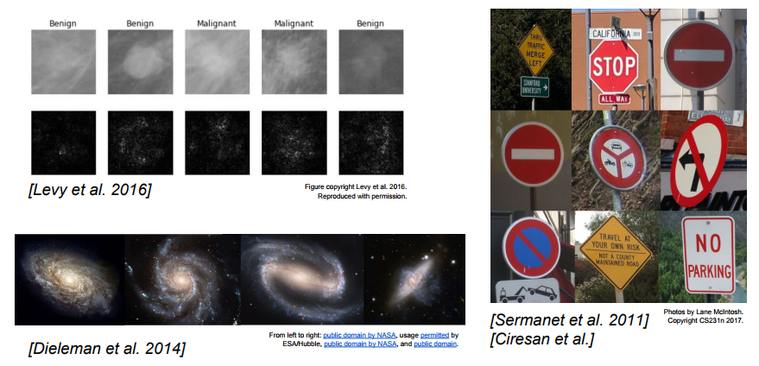
Convolutional Neural Networks

Slide 7
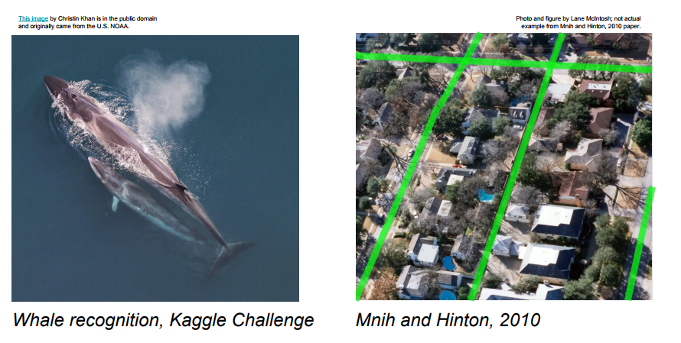
Convolutional Neural Networks

Slide 8
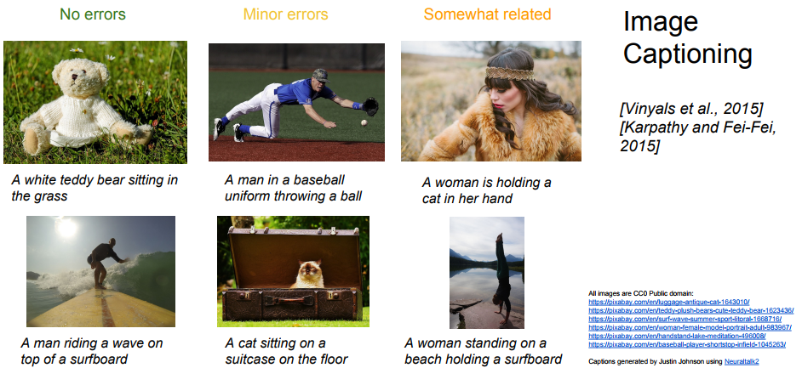
Convolutional Neural Networks

Slide 9
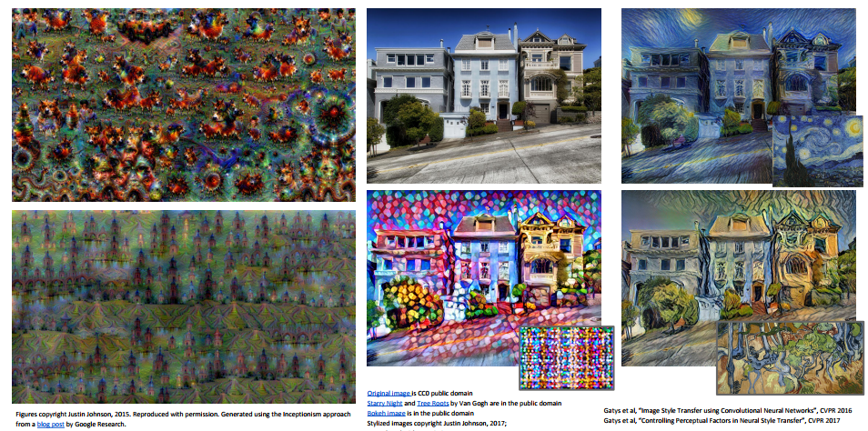
Convolutional Neural Networks

Slide 10
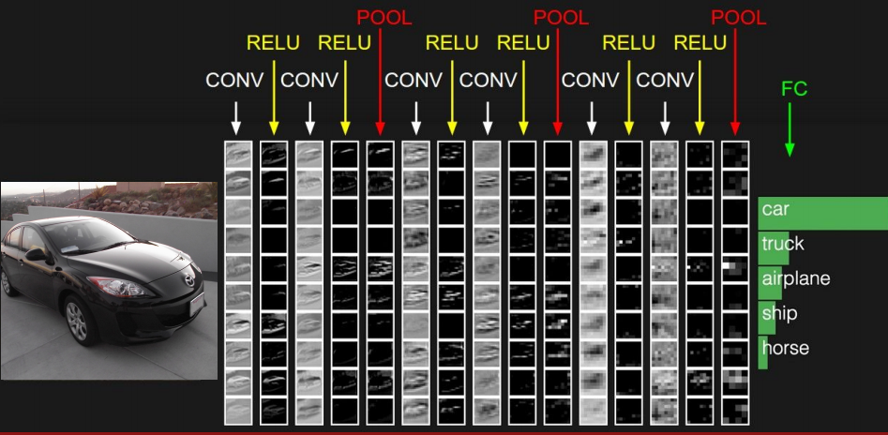
Convolutional Neural Networks

Slide 11
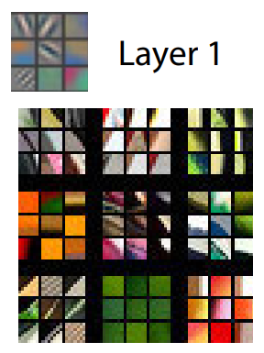
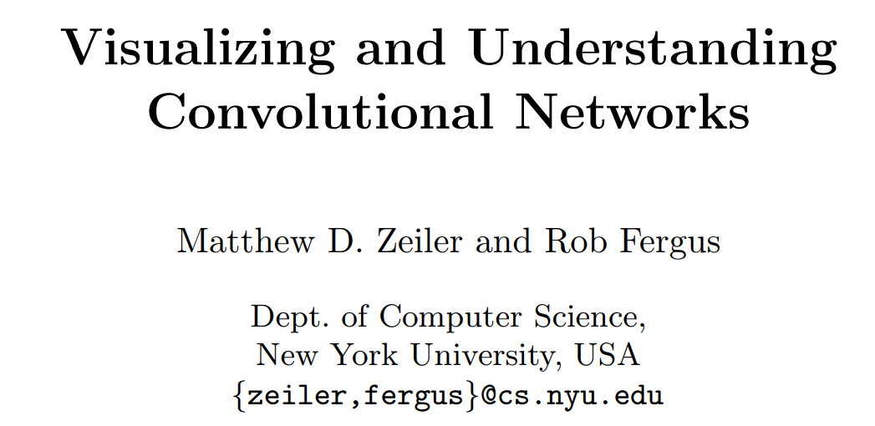
Visualizing and Understanding Convolutional Networks

Slide 12
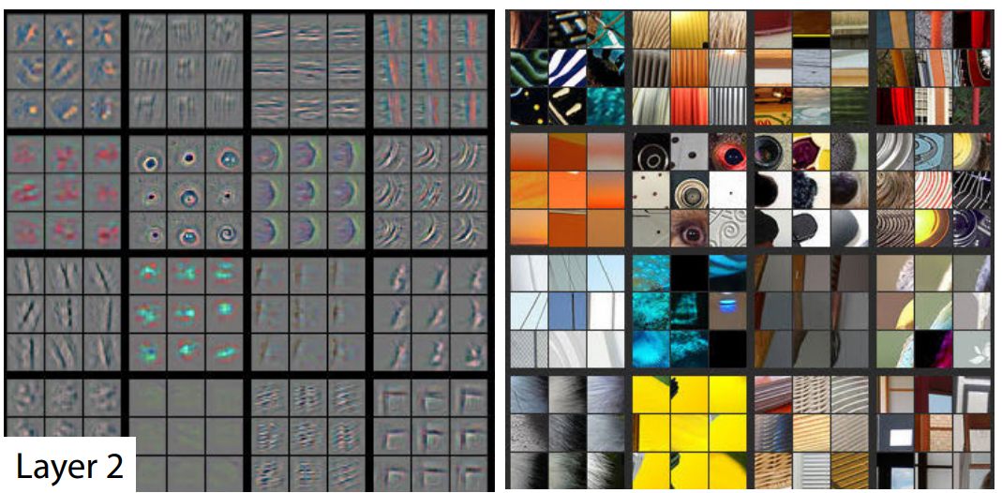
Visualizing and Understanding Convolutional Networks

Slide 13
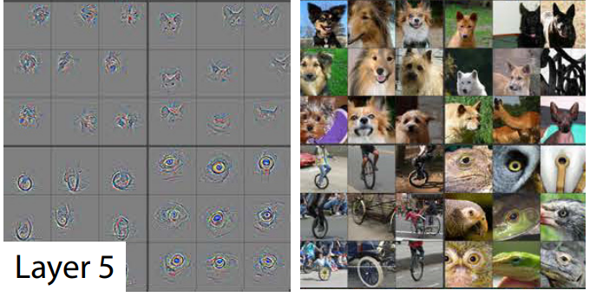
Visualizing and Understanding Convolutional Networks

Slide 14
Convolutional Neural Networks

Slide 15
Reading
https://poloclub.github.io/cnn-explainer/
https://www.analyticsvidhya.com/blog/2021/05/convolutional-neural-networks-cnn/
https://wiki.pathmind.com/convolutional-network
http://cs.stanford.edu/people/karpathy/convnetjs/demo/cifar10.html

Slide 16
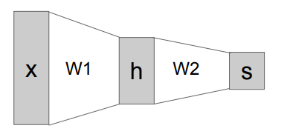
Convolutional Neural Networks
Last time: Neural Networks
Mnist dataset
10
784
100

Slide 17

Kernels

Slide 18
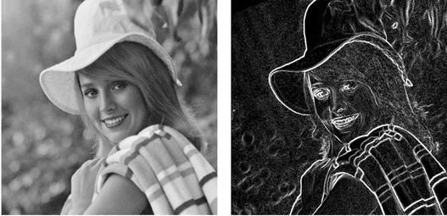
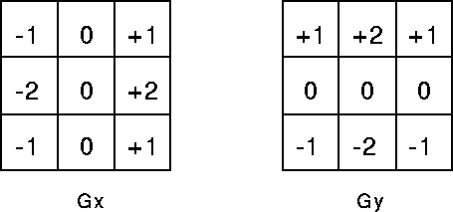
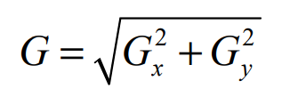
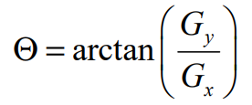
Sobel Filter

Slide 19
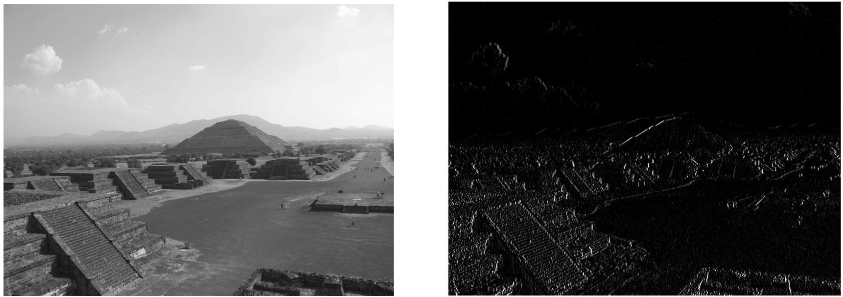
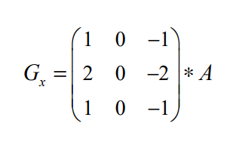
Sobel Filter

Slide 20
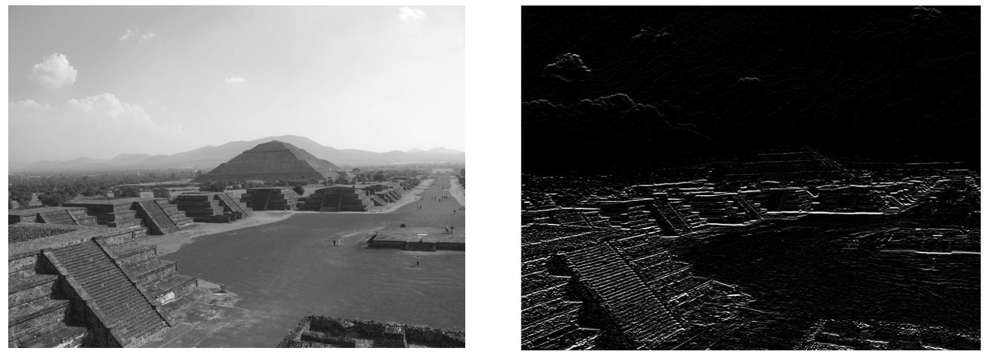
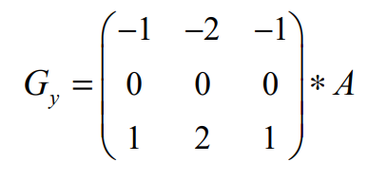
Sobel Filter

Slide 21
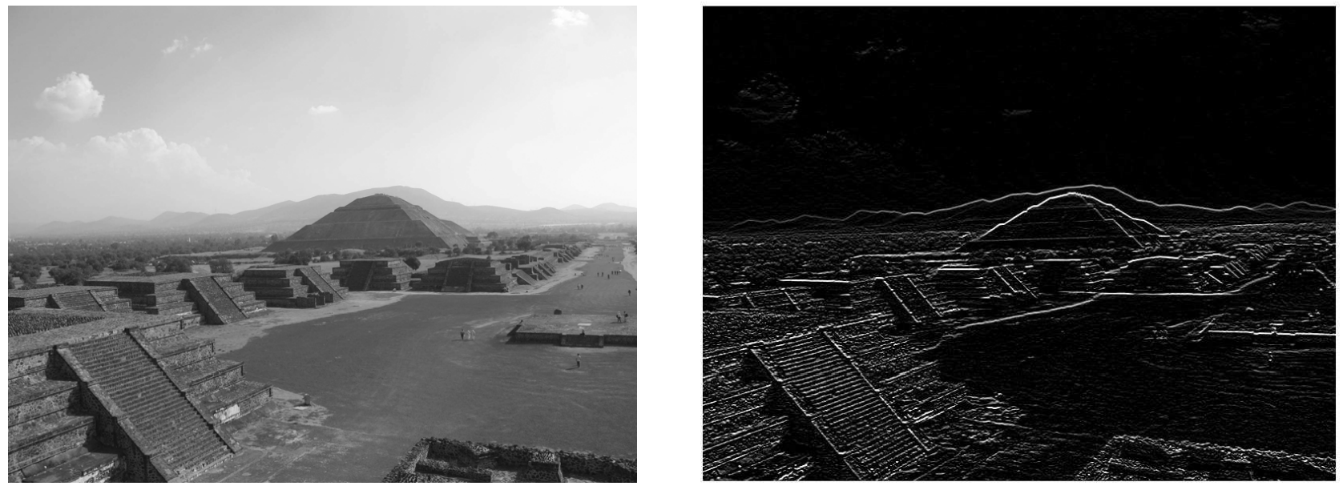
Sobel Filter

Slide 22
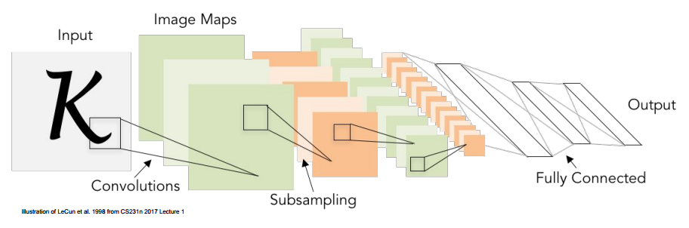
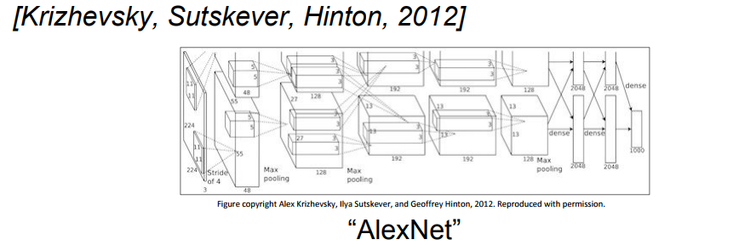
Convolutional Neural Networks

Slide 23

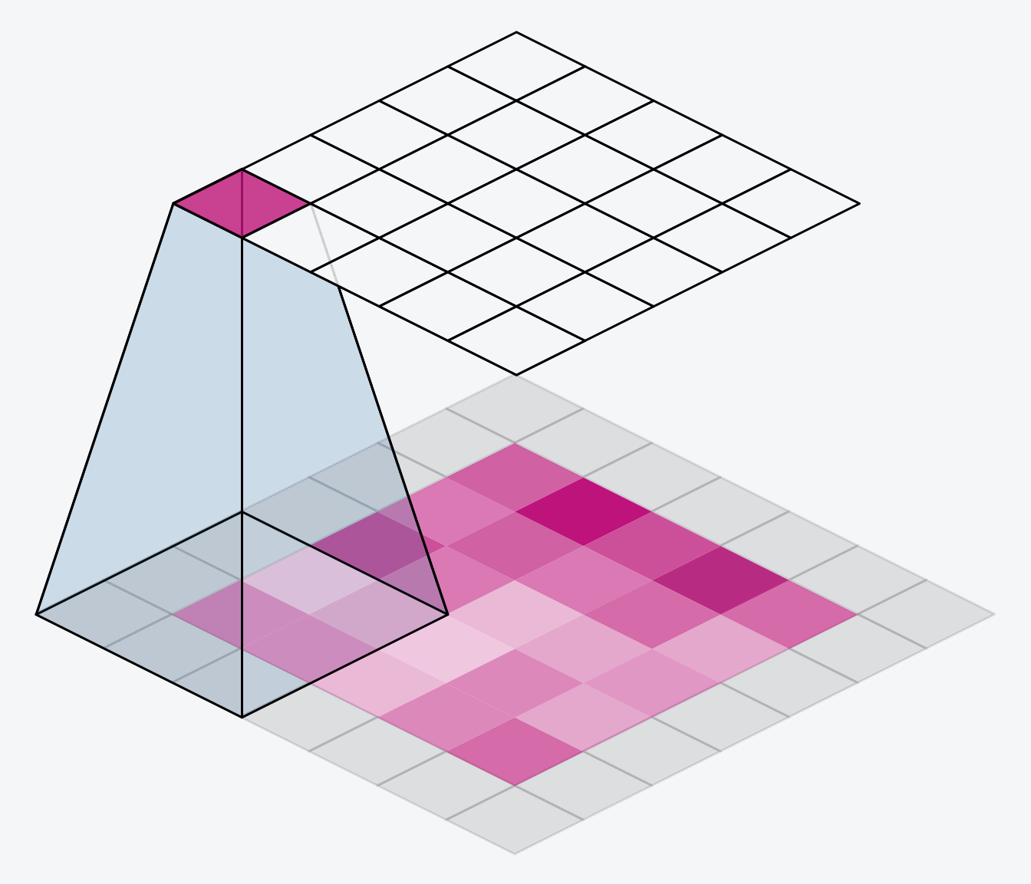
Convolutional Neural Networks
local connectivity
parameter sharing
pooling / subsampling hidden units

Slide 24
Convolutional Neural Networks
Convolutional Neural Networks

Slide 25
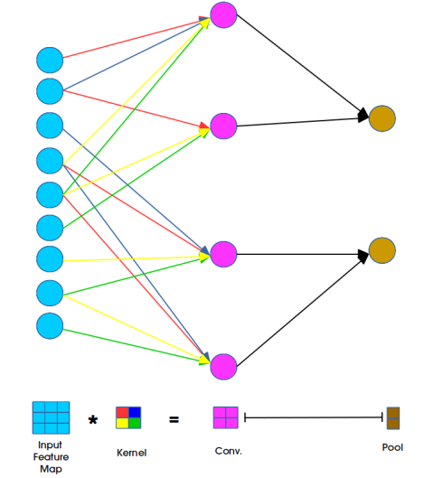
Convolutional Neural Networks
local connectivity
parameter sharing

Slide 26
Layers
Convolution
Activation
Pooling
Dropout
Batch Normalization
Fully connected
…

Slide 27
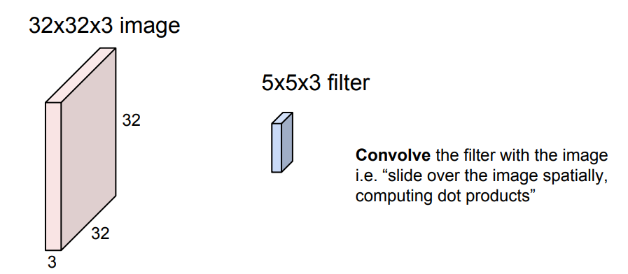
Convolution Layer

Slide 28
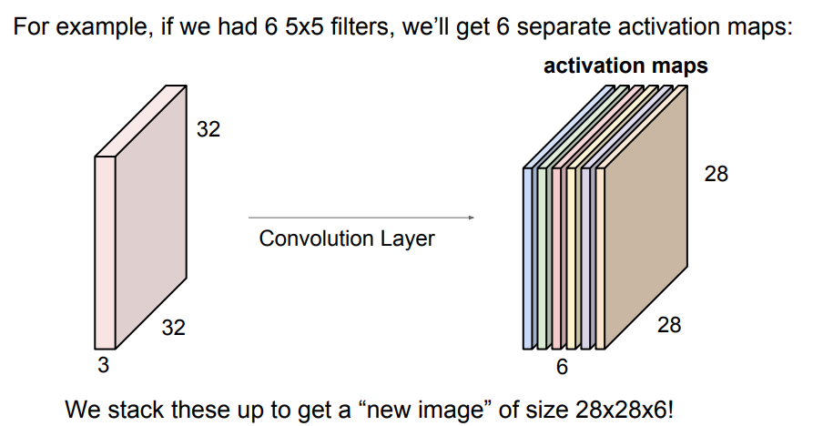
Convolution Layer

Slide 29
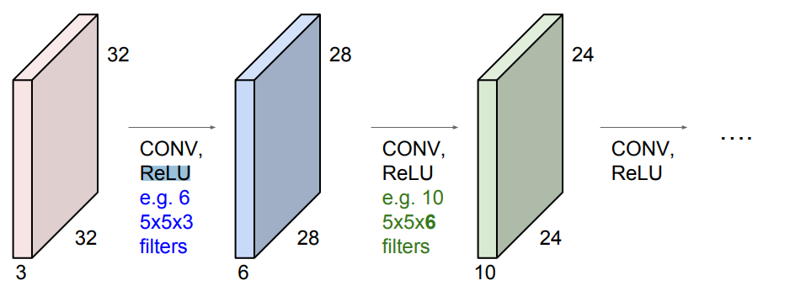
Convolution Layer

Slide 30
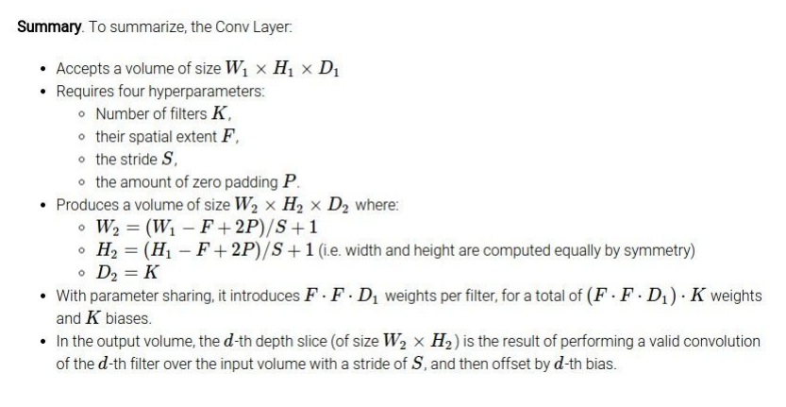
Convolution Layer

Slide 31
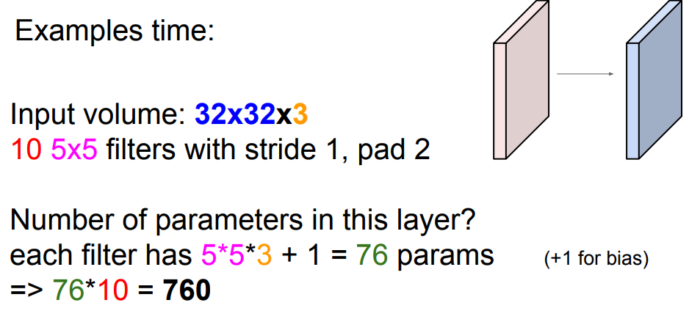
Convolution Layer

Slide 32
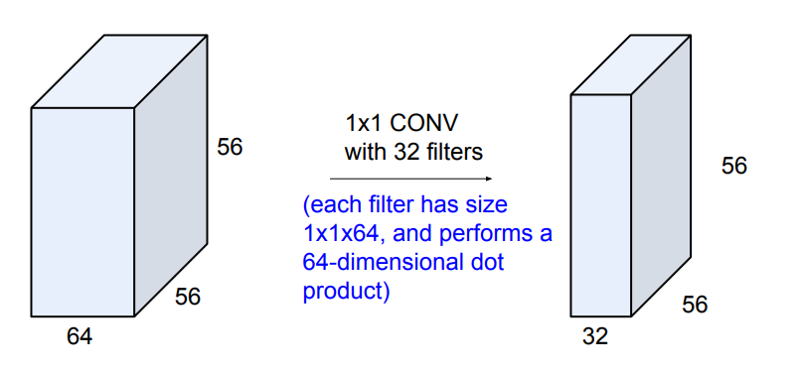
Convolution Layer

Slide 33
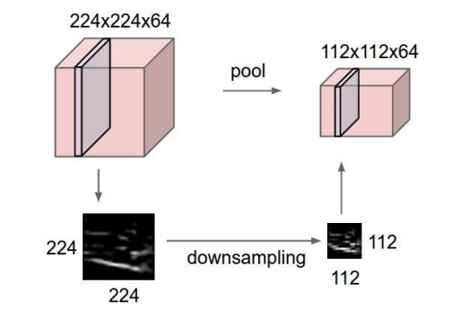
Pooling layer
Makes the representations smaller and more manageable.
Operates over each activation map independently:

Slide 34
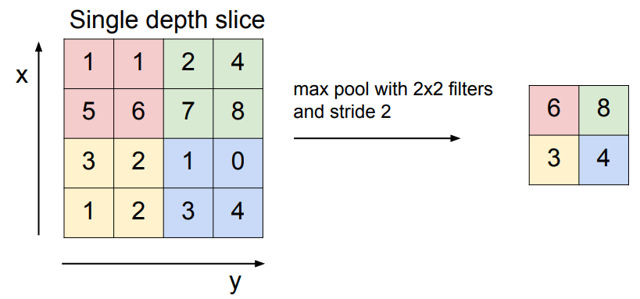
MAX POOLING

Slide 35
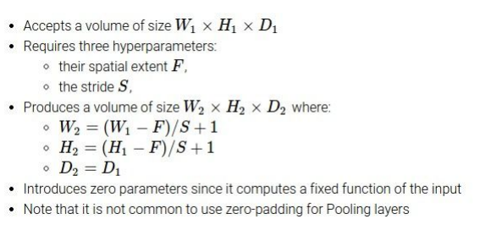
MAX POOLING

Slide 36
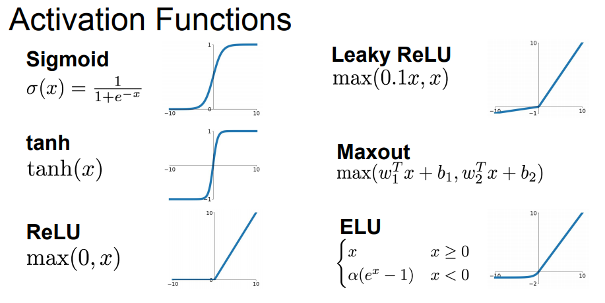
Activation Functions

Slide 37
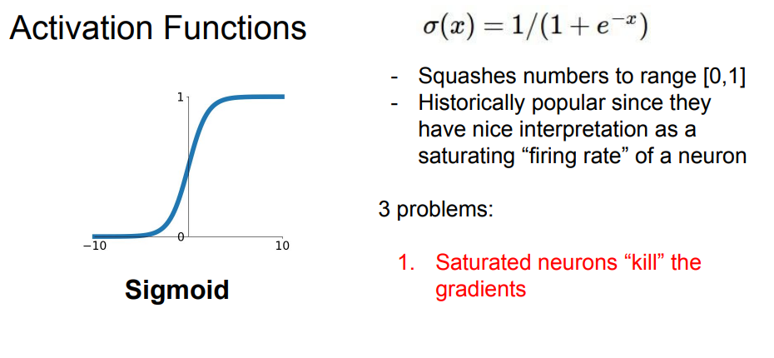
Activation Functions

Slide 38
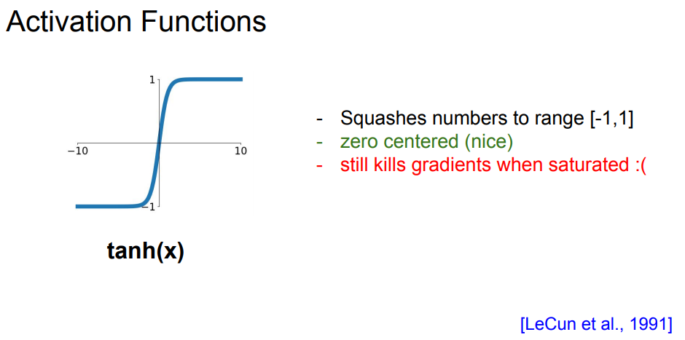
Activation Functions

Slide 39
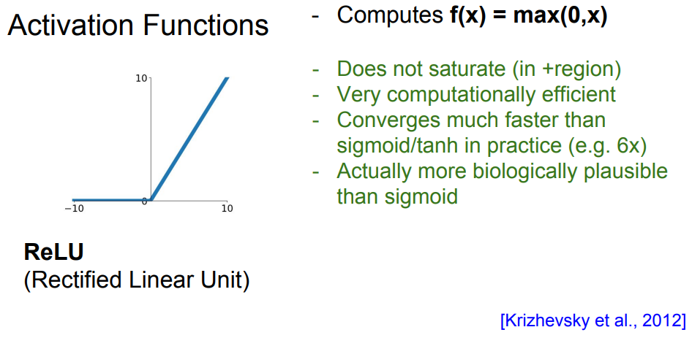
Activation Functions
dead ReLU

Slide 40
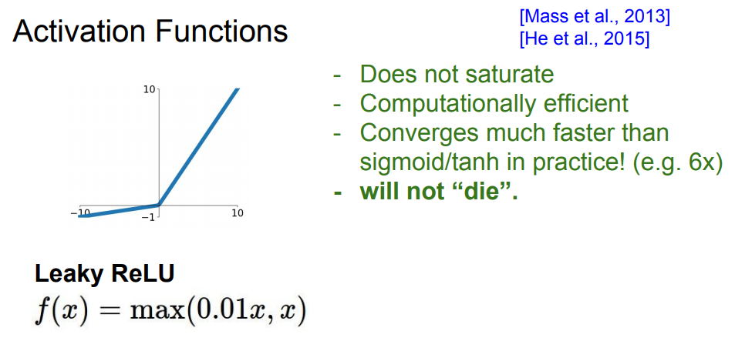
Activation Functions

Slide 41
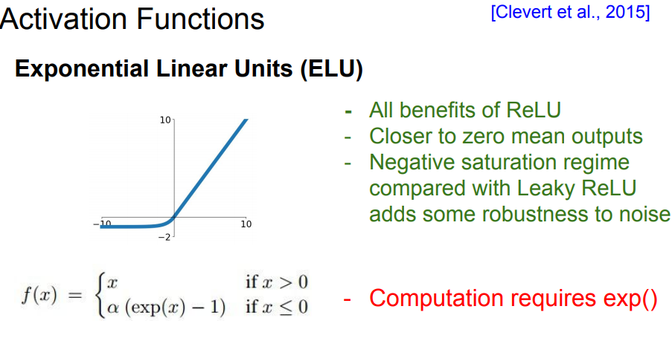
Activation Functions

Slide 42
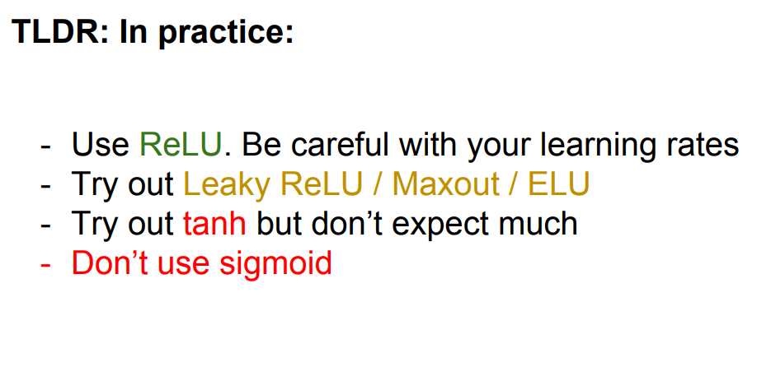
Activation Functions

Slide 43
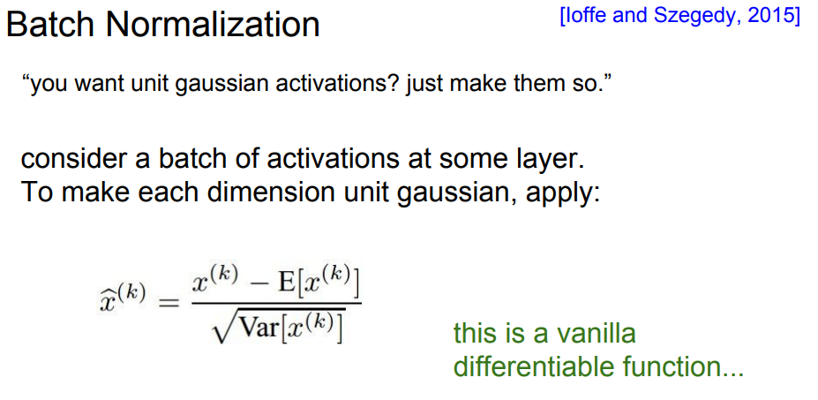
Batch Normalization

Slide 44
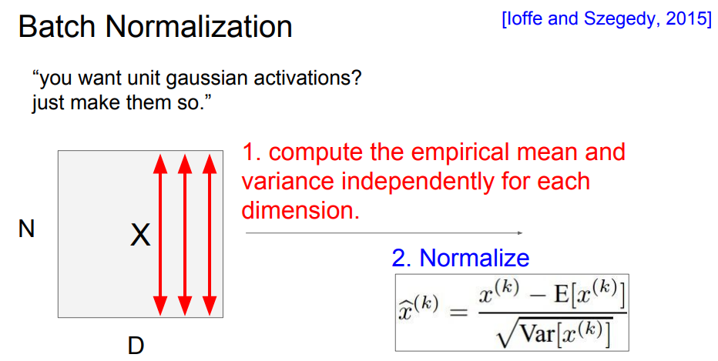
Batch Normalization

Slide 45
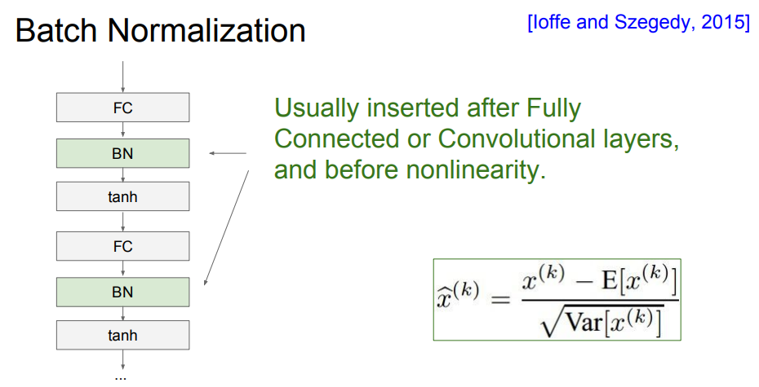
Batch Normalization

Slide 46
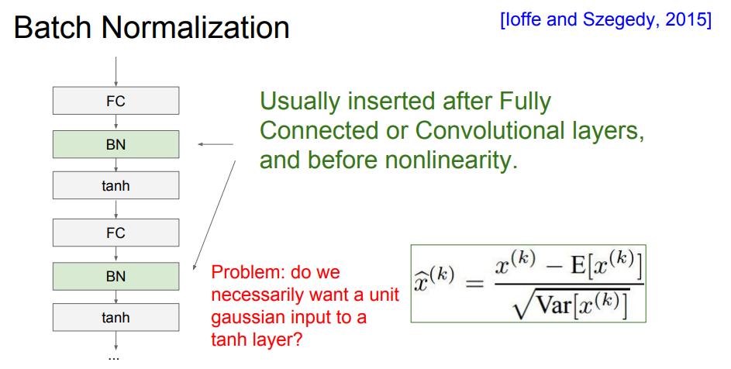
Batch Normalization

Slide 47
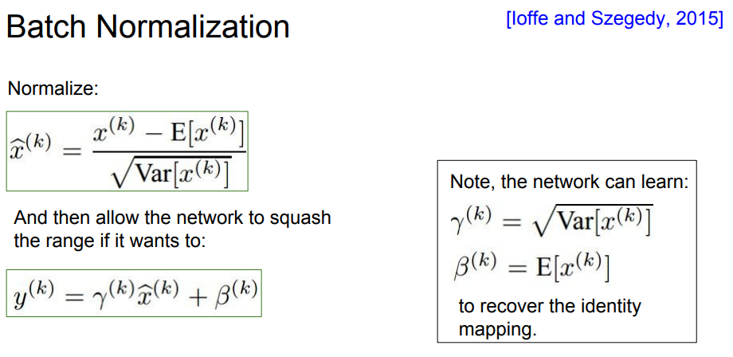
Batch Normalization

Slide 48
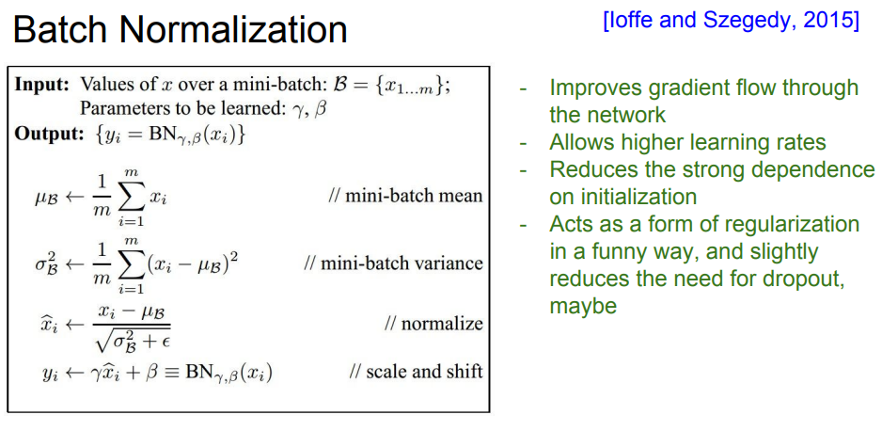
Batch Normalization

Slide 49
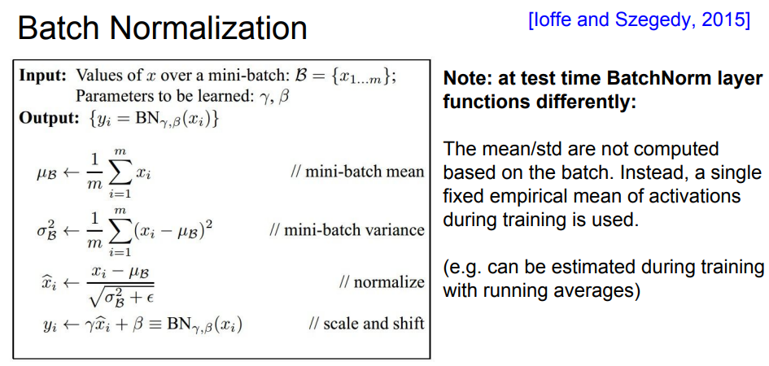
Batch Normalization

Slide 50

Dropout
In each forward pass, randomly set some neurons to zero Probability of dropping is a hyperparameter; 0.5 is common

Slide 51

Dropout

Slide 52

Dropout

Slide 53

Dropout

Slide 54

Dropout

